Slide 1
Augmented Reality: Travel and Tourism
Presented By:
Aravind Sheri
Sharath Koppu
V Bhanu Sudheer
Aditya Somam

Slide 2
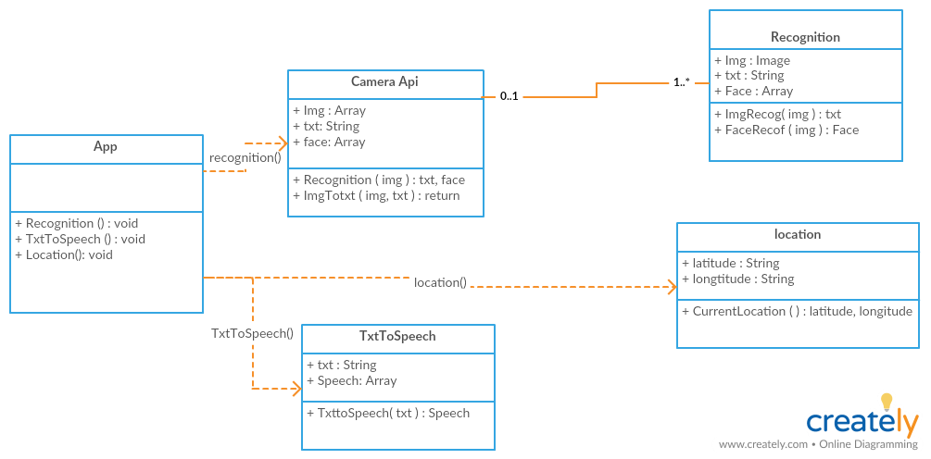
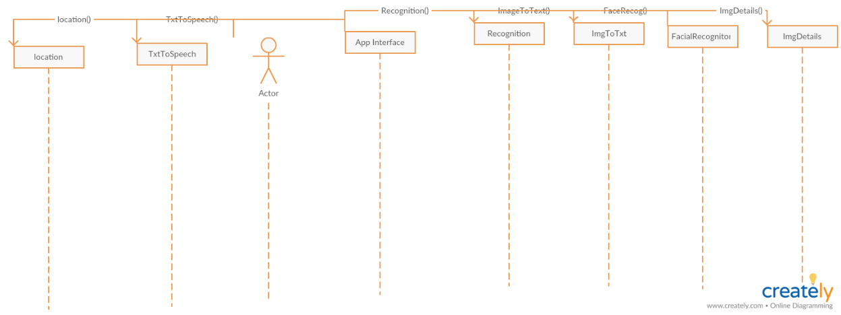
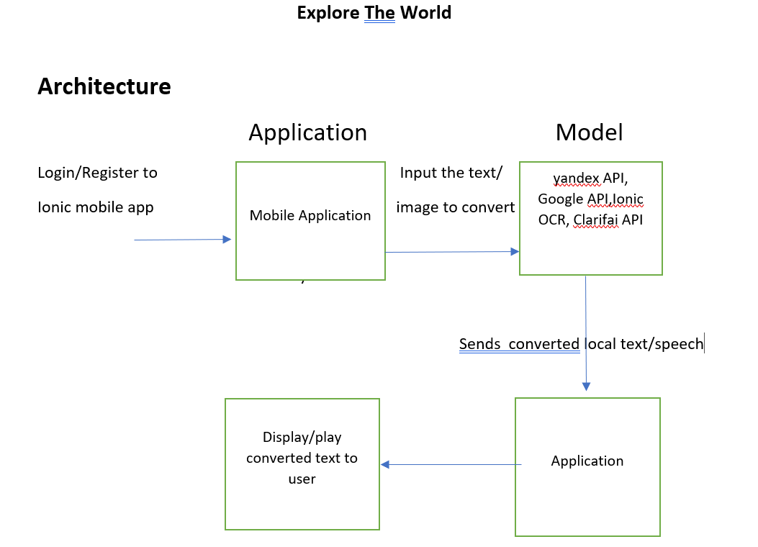
1. Diagrams
Sequence Diagram
UML Diagram

Slide 3
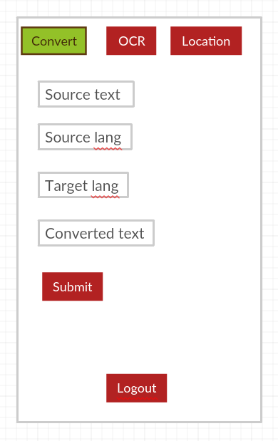
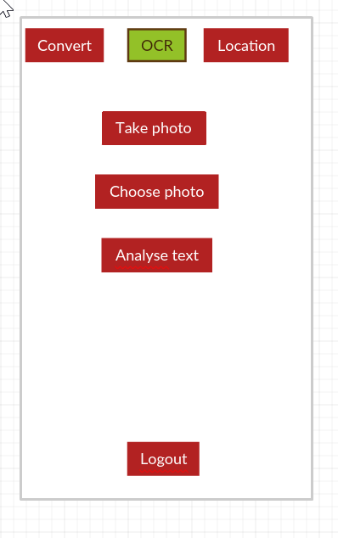
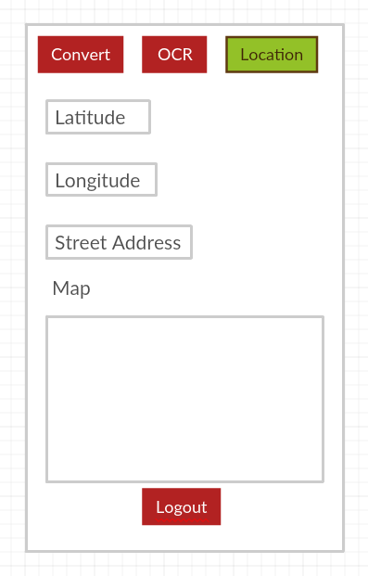
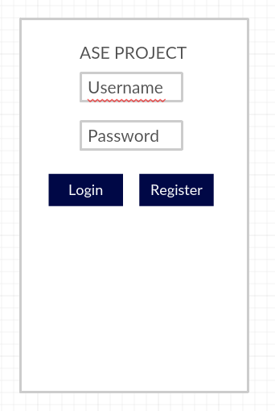
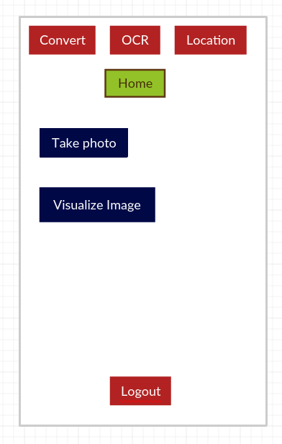
2. Wireframes
Convert
OCR
Location
Login
Home

Slide 4
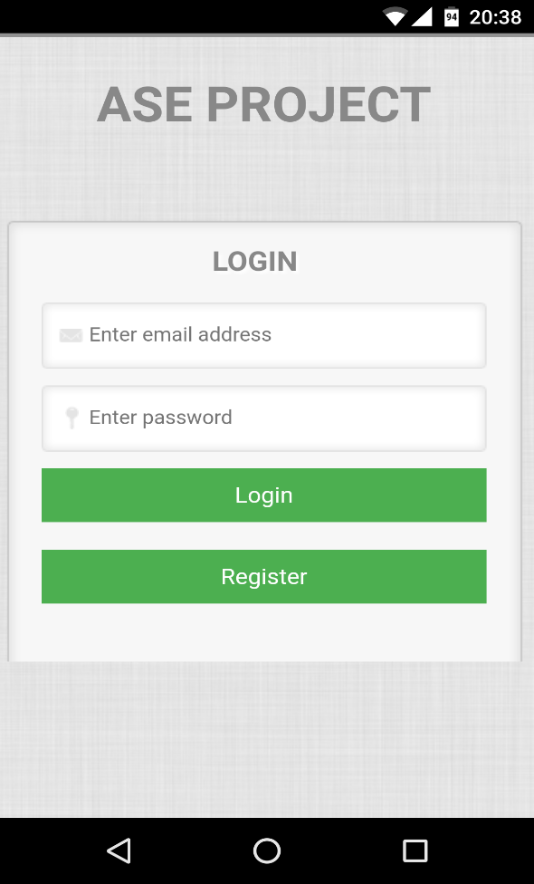
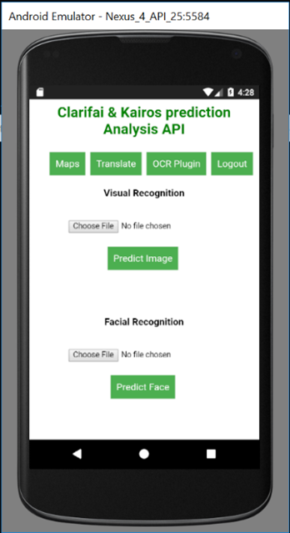
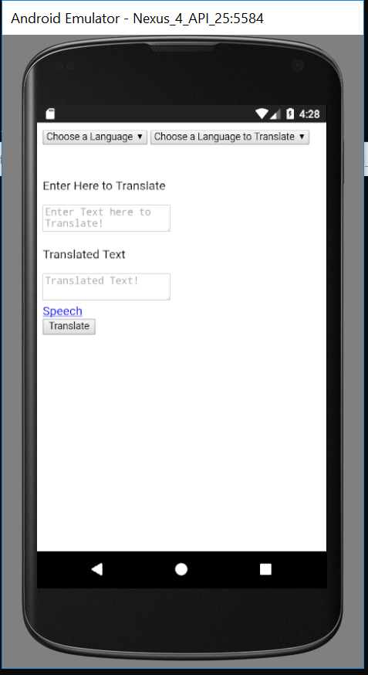
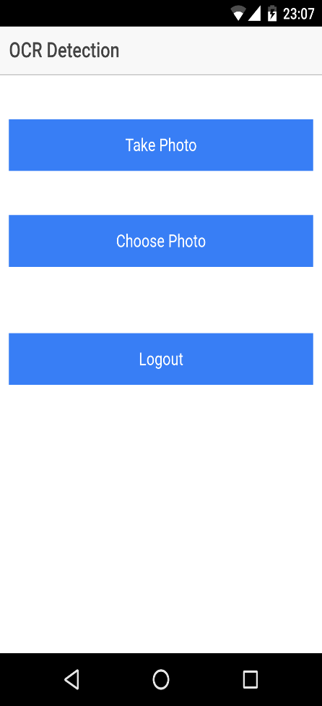
3. Home Screens
Login Screen
Home Screen
Language Translate
OCR Screen

Slide 5
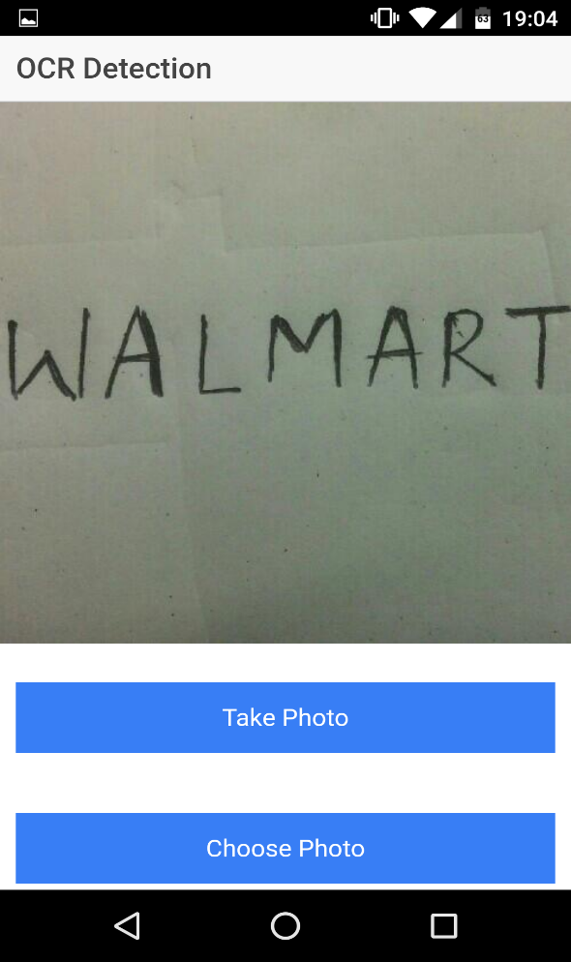
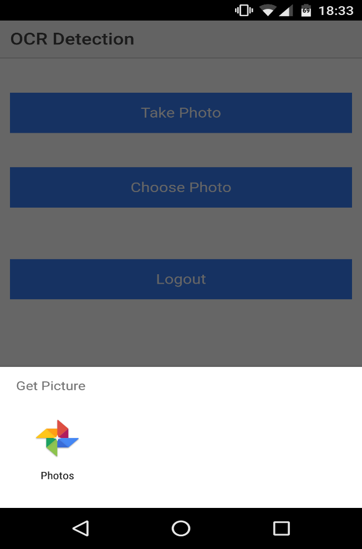
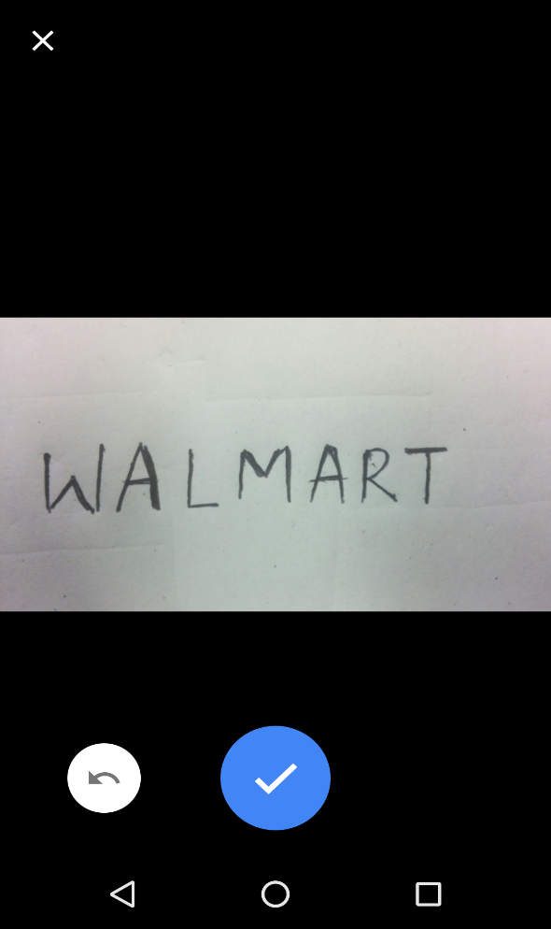
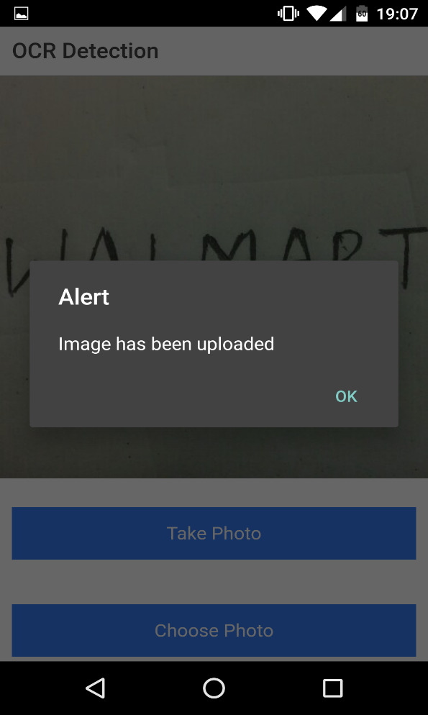
4. Add/Select Images
Take a photo
Choose a photo from memory
OCR Detection
Image uploaded alert

Slide 6
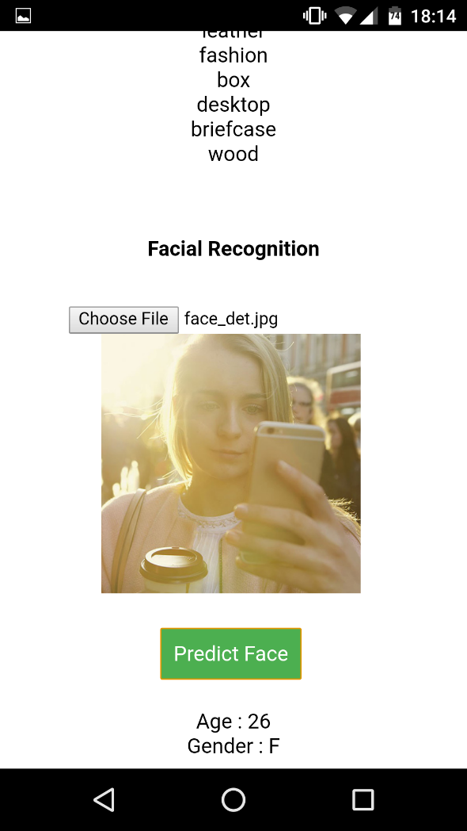
5. Face Recognition

Slide 7
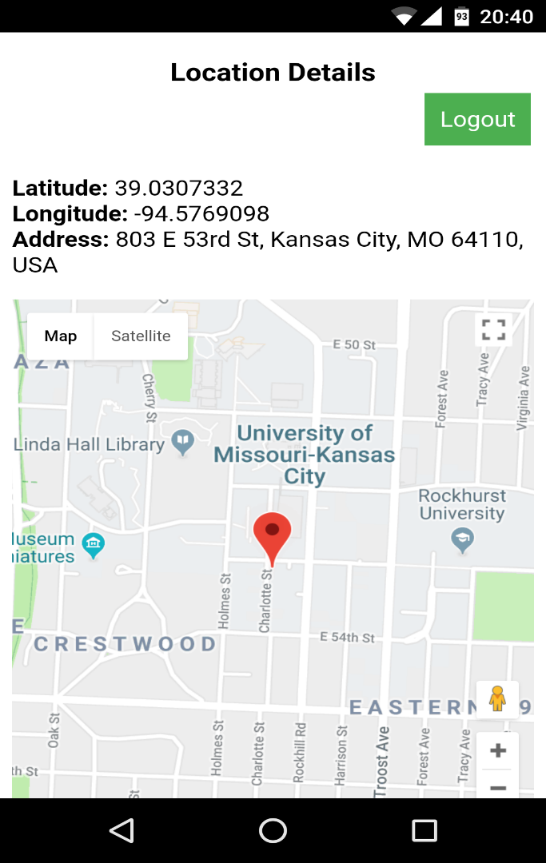
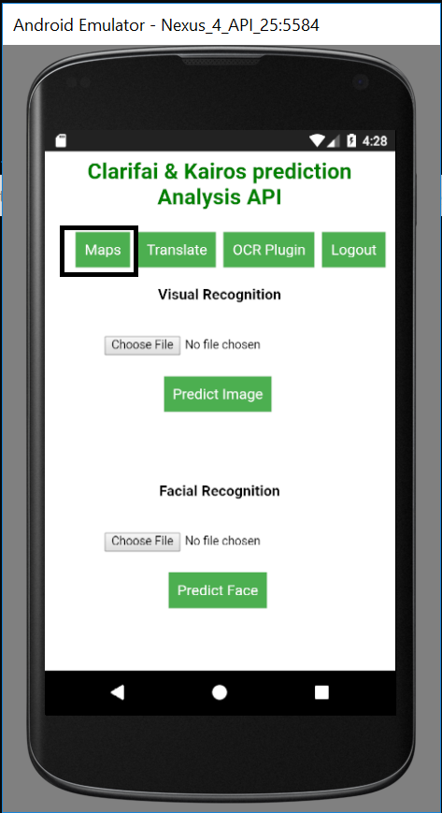
6. Location and Maps
Maps Option
Current Location

Slide 8
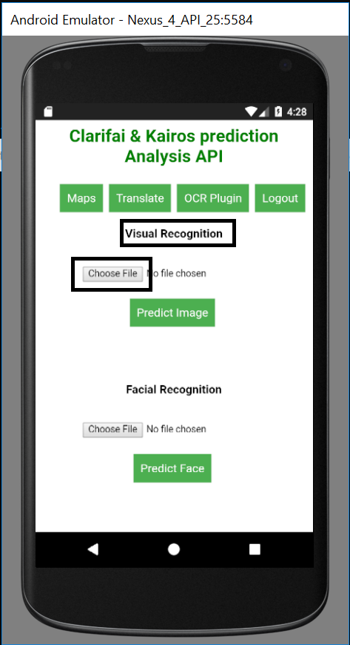
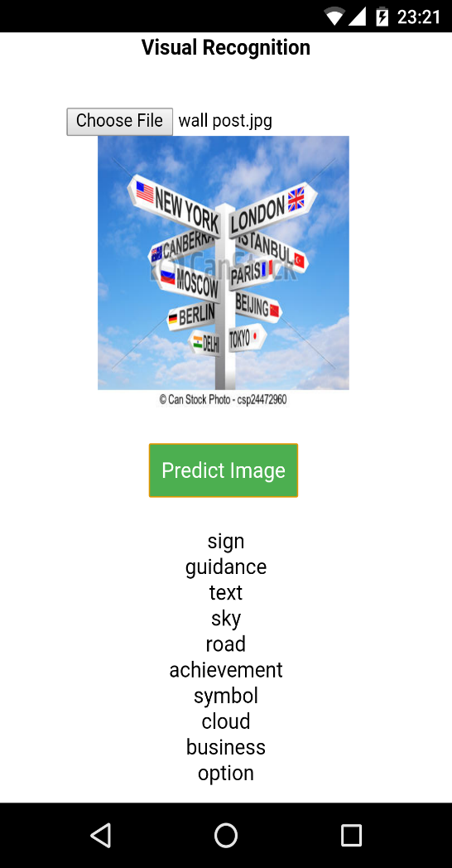
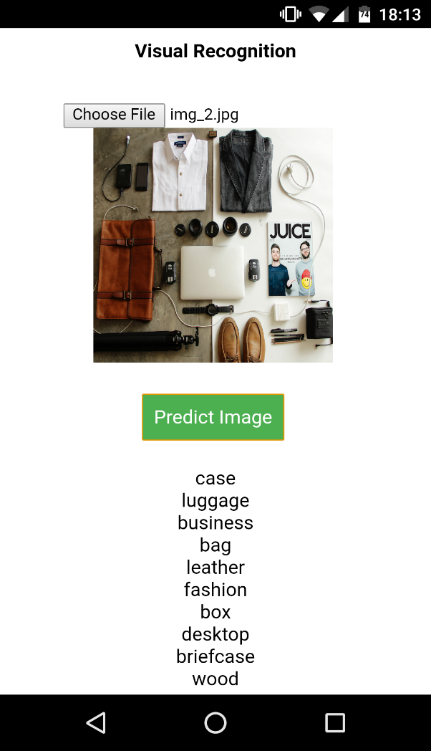
7. Visual Recognition
Visual Detection Option
Visual Recognition
Visual Recognition

Slide 9
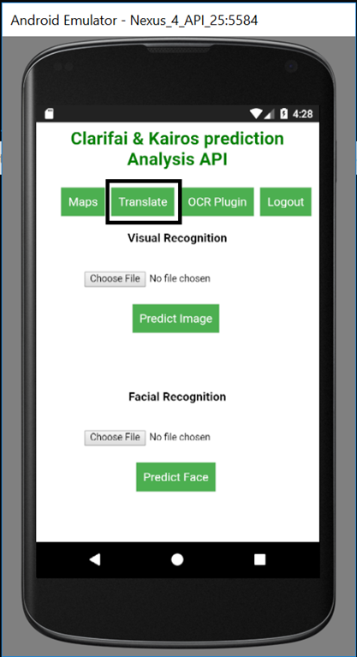
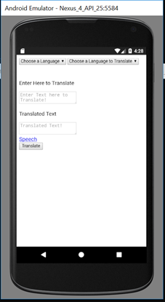
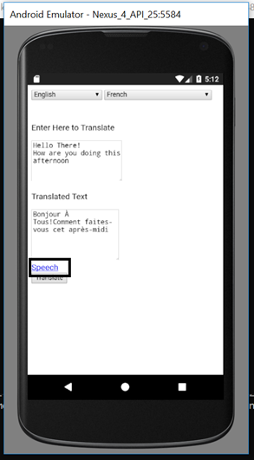
8. Translation
Translate Option
Translation Screen
Speech Option

Slide 10
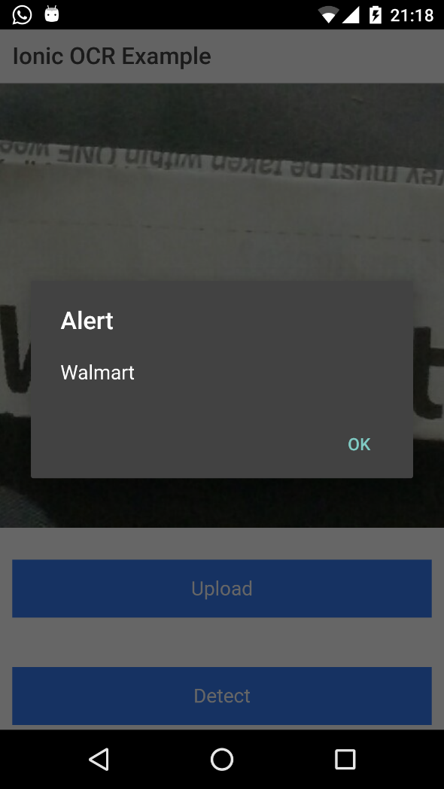
9. OCR Detection

Slide 11
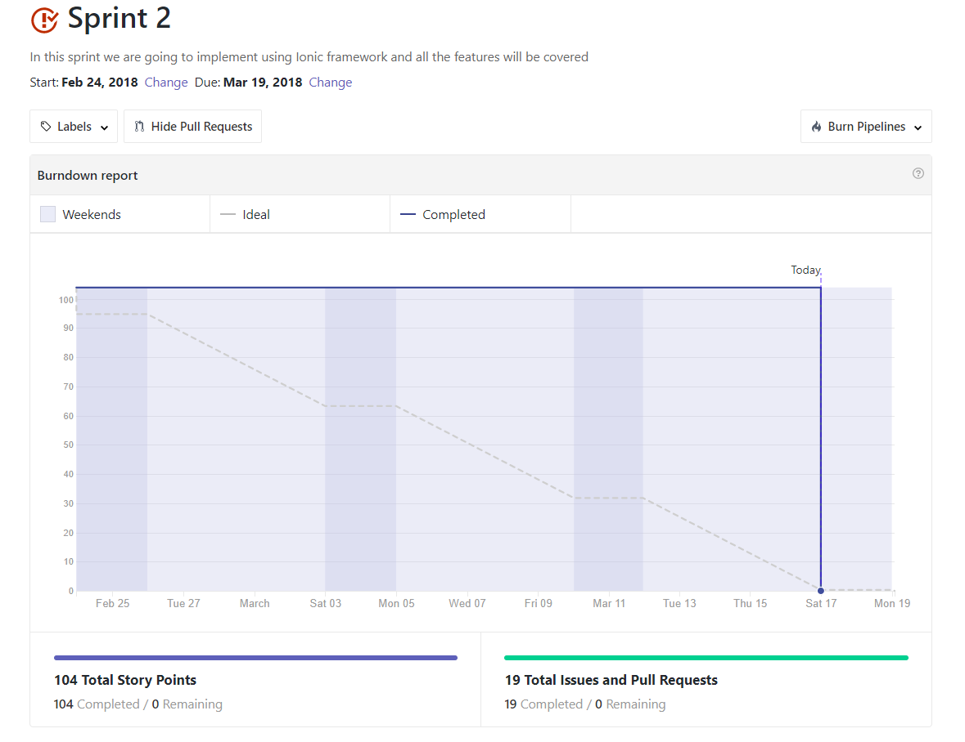
10. Sprint 2 Burndown Chart

Slide 12
Progress
Implemented Visual Recognition
Implemented Face Detection
Implemented Language Translate
Implemented OCR Detection

Slide 13
Future Implementations
Implement auto detect location
Integrate Maps.
Integrate Augmented Reality

